Slide 1
Foreign Direct Investment

Slide 2
Problem Statement
Investment is a game of understanding historic data of investment objects under different events but it is still a game of chances to minimize the risk we apply analytics to find the equilibrium investment.
To understand the Foreign direct investment in India for the last 17 years from 2000-01 to 2016-17. This dataset contains sector and financial year-wise data of FDI in India Sector-wise investment analysis Year-wise investment analysis.
Find key metrics and factors and show the meaningful relationships between attributes

Slide 3
Agenda
Have to create a detailed project report

Slide 4

A picture is worth a thousand words

Slide 5
01
Sector - Wise Analysis

Slide 6
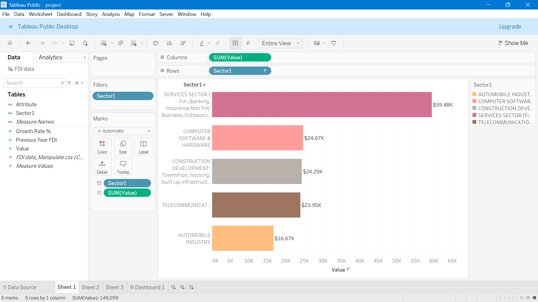

Slide 7
$59,476.49 Million
Top Sector is “Service Sector”
Number of Sectors with Investment: 63

Slide 8
$331,991 Million
Total FDI Investment

Slide 9
02
Year-wise Analysis

Slide 10
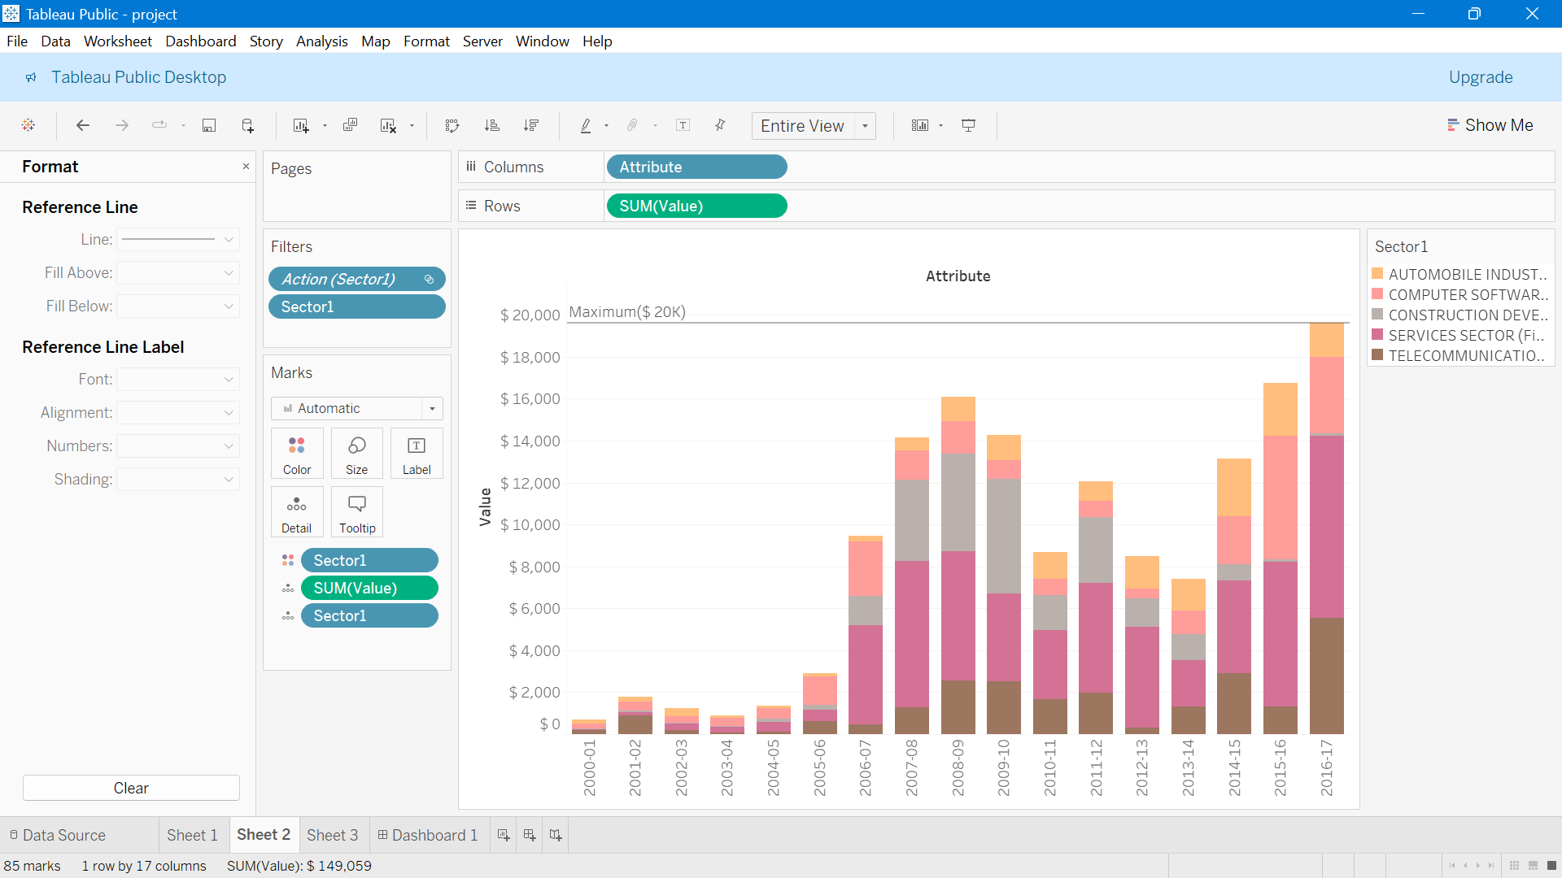

Slide 11
$142,38.20 Million
Average Yearly FDI Investment

Slide 12
Top 5 Performars
$23,946
$24,293
$24,669.49
$59,476.49
Telecommunications
Construction Development
Computer Software & Hardware
Services Sector

Slide 13
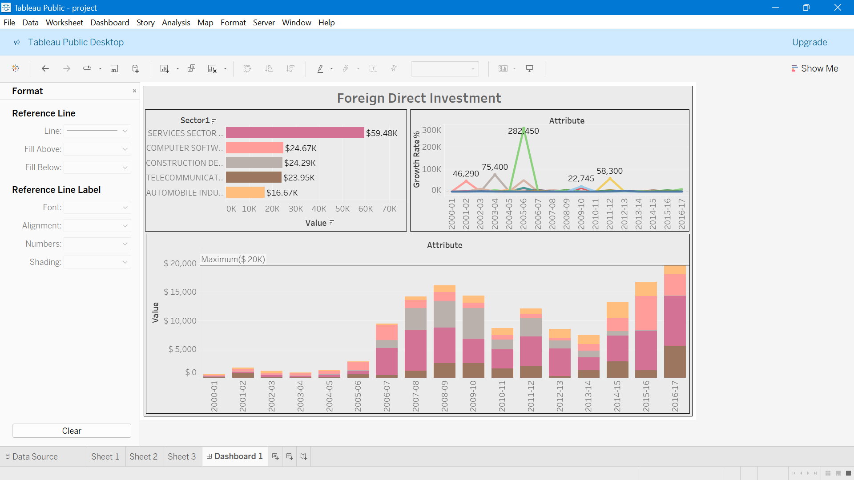
Desktop software
Tableau
https://public.tableau.com/views/project_17169729740670/Dashboard1?:language=en-US&publish=yes&:sid=&:display_count=n&:origin=viz_share_link

Slide 14
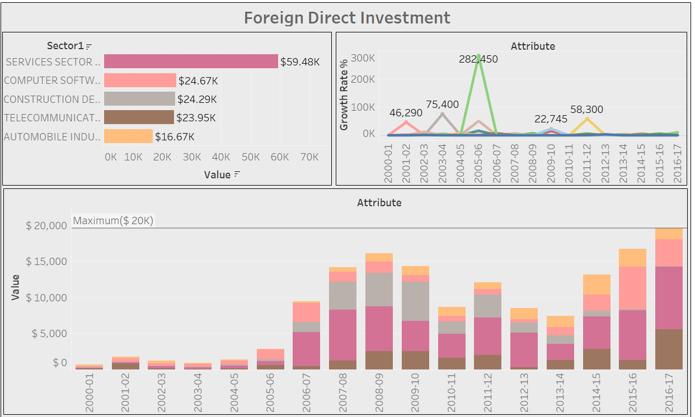
Dashboard

Slide 15


